Slide 1
BUDGET ALLOCATION REVIEW COMMITTEE
Session #7
December 12, 2024

Slide 2
AGENDA
1.
Open Discussion
2.
Discussion of reading materials
3.
Discussion on Principles
4.
Indirect Costs
5.
Key Messages from Session #7

Slide 3

OPEN DISCUSSION

Slide 4

HOMEWORK
What did you take away from the EAB reading materials?
    Any parts of the Budget Design Principles help you think about the next decisions the committee will be making on treatment of revenue or campus/indirect costs?

Slide 5

REFINING PRINCIPLES
Most of the comments on the guiding principles homework centered around:
“While promoting fiscal responsibility and financial sustainability, provide a simple (transparent) predictable, and transparent methodology for allocating resources and managing associated costs”
Many comments were about the word “simple”
As you were reviewing and commenting, how were you thinking about the next decisions the committee will be making on treatment of revenue or campus/indirect costs?

Slide 6

DECISION-MAKING PROCESS
In the last session, BARC members agreed to the following process for decision-making:
    Ranking (relative to criteria or principles)
    Negative Minority
    Consensus
More Disagreement
More Consensus

Slide 7




DECISION LEVELS
Type of Model- Incremental, Incentive-Based, Performance-Based, Activity-Based, etc.
Revenue Allocations, Indirect Costs, and University Funds
Metrics on Each Revenue, Indirect Cost, and University Funds Pool to be allocated

Slide 8
INDIRECT COSTS
How should campus-wide expenses be funded? What level of influence do academic units have over their share of these expenses?
  Through a set percentage?
  Allocated in the model?
How should administrative and support units be funded?
  Through a set percentage?
  Allocated as expenses in the model?
  Hybrid, with some costs off the top and others allocated?
If indirect costs are to be allocated, what variables should be used for each pool?
Current budget model:
    Allocates campus-wide expenses in the model
    Allocates administrative and support unit expenses in the model
    Has seven cost pools, each with its own variables to allocate the expenses

Slide 9
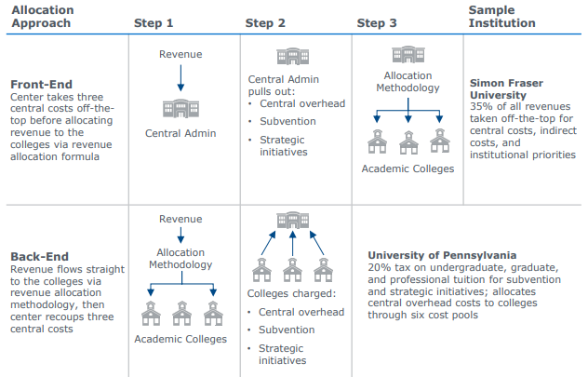
INDIRECT COSTS
Taking central costs off at the front-end:
    Is simple
    Shares increases or decreases in revenue between academic and administrative units
    Can be seen as less transparent, prevents the calculation of a “unit margin”
Allocating central costs “at the back-end” within the model:
    Adds complexity to the model
    Implies that academic units have control over their portion of central costs and can reduce consumption or otherwise change behavior to influence total spending
    Can be seen as more transparent

Slide 10
KEY MESSAGES FROM SESSION #7

Slide 11
WHAT ARE THE KEY MESSAGES FROM THIS SESSION?
Reaffirmed the purpose and charge of the BARC
Reaffirmed the importance the final budget model being “simple”
We need to clarify why we are continuing this process without a chancellor in place and how our incoming chancellor will be involved
The committee members voted and agreed upon the use of a front-end approach to covering campus-wide and central administrative costs

