Slide 1
BUDGET ALLOCATION REVIEW COMMITTEE
Session #6
November 21, 2024

Slide 2
AGENDA
1.
Decision-making continued
2.
Recap from Model Type Survey
3.
Revenue, Indirect Costs, and University Revenue
4.
Primer on Metrics
5.
Key Messages from Session #6

Slide 3
DECISION-MAKING CONTINUED

Slide 4



DECISION LEVELS
Type of Model- Incremental, Incentive-Based, Performance-Based, Activity-Based, etc.
Revenue Allocations, Indirect Costs, and University Funds
Metrics on Each Revenue, Indirect Cost, and University Funds Pool to be allocated

Slide 5
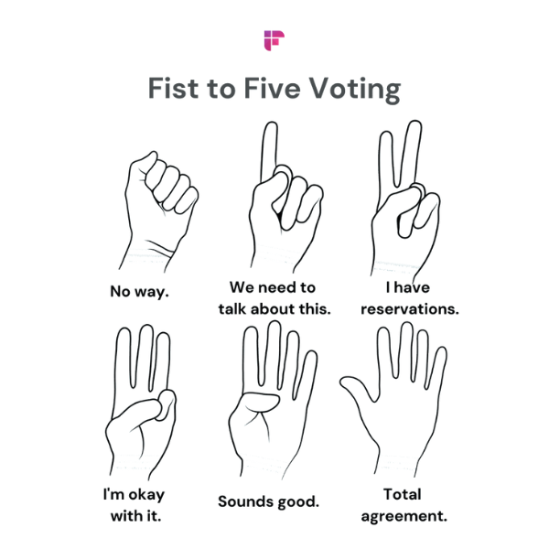
DECISION-MAKING PROCESS
In the last session, BARC members agreed to the following process for decision-making:
    Ranking (relative to criteria or principles)
    Negative Minority
    Consensus
More Disagreement
More Consensus

Slide 6
DECISION-MAKING PROCESS
In the last session, there was limited discussion of time-bounding decisions. This is important given that the BARC has a limited number of meeting sessions (only 6!) left before a complete recommended model is scheduled to be delivered to the new chancellor.
    For context, there are approximately 25 decision points in the current budget model.
    We will likely always be asking for the group to make recommendations with potentially incomplete information.
What will help guide decision-making is refining the guiding principles. Remember, step #1 in the agreed-upon decision-making process is ranking relative to criteria or principles.
In absence of having these principles, the group is looking to what other institutions do. While this can be helpful, CU Denver is not the same as other institutions and our model needs to align with who we are and what our priorities are.

Slide 7
PROPOSAL FOR NEXT THREE WEEKS
The BARC has a communication window from November 21st – December 12th, with campus Learning Sessions scheduled for December 4th and 5th.
We would like to propose cancel the December campus learning sessions and repurpose this time for the BARC.
The proposal for the group: Can we split up into small groups to propose the first round of refinement of principals?
    Groups of three, each group working on one of the existing guiding principles. The goal would be to recommend any changes to the language of the guiding principal to align with the BARC success criteria, add specificity, and make it measurable.
    While doing this work, also consider how would your refinement or the principle itself influence your recommendations for the level 2 decision items.

Slide 8
RECAP FROM MODEL TYPE SURVEY

Slide 9
MODEL TYPE SURVEY RESULTS
 | Rank 1 | Rank 2 | Rank 3 | Top Two | Top Three | Remove
Contemporary Decentralized Budgeting | 6 | 4 | 0 | 10 | 10 | 3
Responsibility Center Management (RCM) | 4 | 2 | 3 | 6 | 9 | 1
Performance-Based Budgeting (PBB) | 1 | 4 | 6 | 5 | 11 | 2
Incremental Budgeting | 3 | 2 | 2 | 5 | 7 | 3
Centralized Budgeting | 1 | 1 | 1 | 2 | 3 | 9
Zero-Based Budgeting (ZBB) | 0 | 1 | 0 | 1 | 1 | 7
Activity-Based Budgeting (ABB) | 0 | 1 | 0 | 1 | 1 | 7
Each Tub on its Own Bottom (ETOB) | 0 | 0 | 0 | 0 | 0 | 12

Slide 10
MODEL TYPE SURVEY RESULTS
Based on the results, the models that appear to fall into “negative minority” are:
    Centralized
    Zero-Based Budgeting (ZBB)
    Activity-Based Budgeting (ABB)
    Each Tub on its Own Bottom (ETOB)
The remaining can be categorized into two broad definitions:
    Incentive/Outcome Based
        Contemporary Decentralized Budgeting
        Responsibility Center Management (RCM)
        Performance-Based Budgeting (PBB)
    Incremental

Slide 11
LEVEL 1 DECISION POINT
Do we have consensus from BARC members to proceed with these two broad model types for consideration?
    Incentive/Outcome Based
    Incremental

Slide 12
DECISION LEVELS
Type of Model- Incremental, Incentive-Based, Performance-Based, Activity-Based, etc.
Revenue Allocations, Indirect Costs, and University Funds
Metrics on Each Revenue, Indirect Cost, and University Funds Pool to be allocated

Slide 13
TREATMENT OF REVENUE, INDIRECT COSTS, AND UNIVERSITY REVENUES

Slide 14
LEVEL 2 DECISION POINTS
Topic | Discussion Points
Revenue Allocations | What incentives should be created through revenue allocations? Based on desired incentives, how should each type of unrestricted fund revenues be treated? Pooled or direct allocation? How should auxiliary revenues be treated? Pooled or direct allocation?
Indirect Costs | How should campus-wide expenses be funded? Front-end, allocated, or back-end? How should administrative and support units be funded? Front-end, allocated, or back-end? If indirect costs are to be allocated, what variables should be used for each pool?
University Revenues (Mission Enhancement Fund) | How should funds for units not able to cover their direct expenses be created? Front-end or back-end? How should funds for strategic initiatives be created? Front-end or back-end? Should select revenue(s) be retained or should a formula help create this? If select revenues are retained, which ones should be considered? If a formula/participation rate is selected, what funds should be subject or exempt from the rate?

Slide 15
REVENUE ALLOCATIONS
What incentives should be created through revenue allocations?
  Instruction, majors, research, outcomes/outputs?
Based on desired incentives, how should each type of unrestricted fund revenues be treated?
  Tuition
  Differential tuition
  State support
  Indirect Cost Recovery
How should auxiliary revenues be treated?
  Extended Studies
  Sales & Services of Educational Activities
Current budget model:
    Pools tuition revenue and allocates based on instruction and majors
    Pools state support and allocates incrementally
    Pools indirect cost recovery and allocates based on sponsored research expenditures
    Directly allocates auxiliary revenues to the academic units, but this revenue has no impact on the unrestricted fund budget

Slide 16
INDIRECT COSTS
How should campus-wide expenses be funded? What level of influence do academic units have over their share of these expenses?
  Through a set percentage?
  Allocated in the model?
How should administrative and support units be funded?
  Through a set percentage?
  Allocated as expenses in the model?
  Hybrid, with some costs off the top and others allocated?
If indirect costs are to be allocated, what variables should be used for each pool?
Current budget model:
    Allocates campus-wide expenses in the model
    Allocates administrative and support unit expenses in the model
    Has seven cost pools, each with its own variables to allocate the expenses

Slide 17
UNIVERSITY REVENUES (MISSION ENHANCEMENT FUND)
How should funds for units not able to cover their direct expenses be created?
How should funds for strategic initiatives be created?
Should select revenue(s) be retained or should a formula help create this?
If select revenues are retained, which ones should be considered?
If a formula/participation rate is selected, what funds should be subject or exempt from the rate?
Current budget model:
    Includes the Mission Enhancement Fund, which supports units that are not able to cover direct expenses as well as strategic initiatives
    Uses a formula to create the Mission Enhancement Fund

Slide 18
METRICS PRIMER

Slide 19
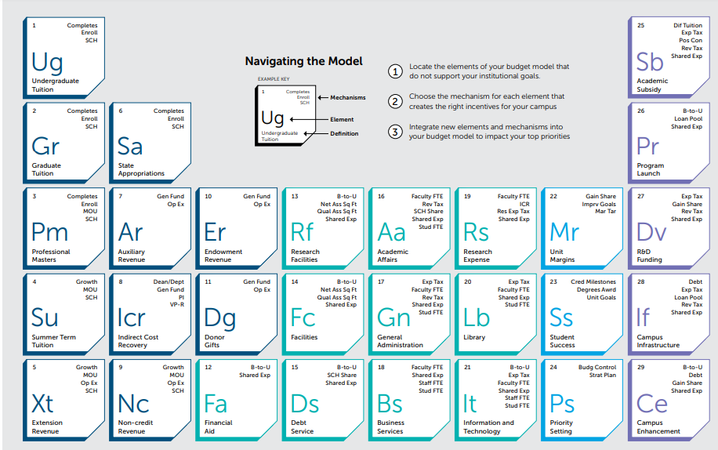
EAB’S PERIODIC TABLE OF BUDGET MODEL ELEMENTS

Slide 20
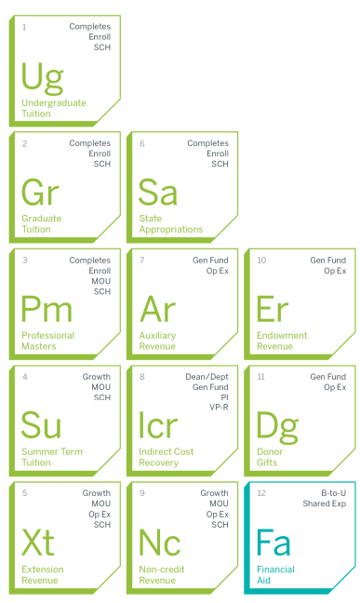
Revenue allocation elements represent different sources of university revenues.
While not all of these apply to CU Denver, these start to give ideas of what types of metrics the committee can choose to recommend based on the decision points identified.
    What incentives should be created through revenue allocations?
    Based on desired incentives, how should each type of unrestricted fund revenues be treated? Pooled or direct allocation?
    How should auxiliary revenues be treated? Pooled or direct allocation?

Slide 21
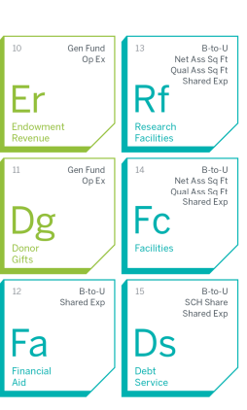

Cost allocation elements represent different components of the university’s overhead.
While not all of these apply to CU Denver, these start to give ideas of what types of metrics the committee can choose to recommend based on the decision points identified.
    How should campus-wide expenses be funded? Front-end, allocated, or back-end?
    How should administrative and support units be funded? Front-end, allocated, or back-end?
    If indirect costs are to be allocated, what variables should be used for each pool?

Slide 22

Performance Target elements represent types of objectives that can be defined within the budget process.
CU Denver does not utilize performance targets as part of its current budget model.
A pool of funds could be used as a mechanism to formally incorporate performance goals into the resource allocation methodology.
    This could be the “strategic initiatives pool” or a separate pool.

Slide 23
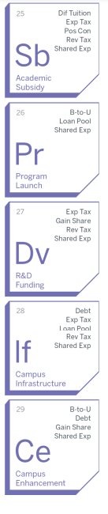
Strategic Funding elements represent distinct categories of institutional strategic objectives that require centralized discretionary funding.
CU Denver utilizes the Mission Enhancement Fund for these.
    “Academic Subsidy” = “Subvention”
    All other strategy-based funding would be the “strategic initiatives pool”

Slide 24
KEY MESSAGES FROM SESSION #6

Slide 25
WHAT ARE THE KEY MESSAGES FROM THIS SESSION?
Reached consensus on the types of budget model structures to explore further:
    Incentive/Outcomes based (including contemporary decentralized, responsibility centered management, and performance-based)
    Incremental
The group agreed about the importance of simplicity in the model
The group began learning about metrics and began discussing the potential impacts
The group agreed to spend time asynchronously on the current model’s guiding principles and success criteria to begin refining, defining, and prioritizing the future model’s guiding principles

Slide 26
BUDGET MODELS IN HIGHER EDUCATION
COMMON HIGHER EDUCATION BUDGET MODELS
Centralized Budgeting | Incremental Budgeting | Zero-Based Budgeting (ZBB) | Performance-Based Budgeting (PBB) | Activity-Based Budgeting (ABB) | Incentive-Based Budgeting
Concentrates decision-making authority with upper-level administrators. While historical data may be considered, this model primarily focuses on allocating resources based on institutional needs and priorities. | Allocations for the upcoming year are based on the previous year’s figures. Usually, adjustments are made considering the changes in revenue streams and expenses — including factors like inflation, enrollment fluctuations, or facilities’ investments. | Zero-based budgeting wipes out the previous year’s budget and restart the new fiscal year from zero. In this financial model for higher education, departments will make a bid for funding and justify all operation and capital requests every year. | Performance-based budgeting is used to award funds based on performance (output). It offers a direct budgetary impact from achieving the desired goals, through different parameters such as enrollment growth and graduation rates. | Activity-based budgeting allocates resources to institutional activities that offer the greatest returns (e.g. increased revenues, investments). While PBB awards funds based on output, ABB considers the amount of revenue-generating activity a unit undertakes (inputs). | Incentive-based budget models give operational authority to the units and divisions within the university. Each unit receives its own revenues allocation (e.g. tuition of its enrolled students) and is responsible for its own expenses. Hence, giving them more control over their finances.
*Shading indicates CU Denver’s current budget model type

Slide 27
INCENTIVE-BASED BUDGET MODELS
INCENTIVE-BASED BUDGET MODEL SPECTRUM
Contemporary Decentralized Budgeting | Responsibility Center Management (RCM) | Each Tub on its Own Bottom (ETOB)
Higher degree of central control Academic units are allocated a majority of the revenue budget but also have a higher participation fee to build a larger central funding pool (“Mission Enhancement Fund”) This allows for greater ability to subsidize academic units, fund strategic initiatives, and support mission-related programs | Some centralized control Academic units are allocated most of the revenue budget but give up some through a participation fee to build a larger central funding pool Some ability to subsidize academic units, fund strategic initiatives, and support mission-related programs | Extremely decentralized model Academic units essentially operate as their own financial entities Very little strategic control held centrally No sympathy for market forces Academic units that cannot fund their operation must cut costs or generate more revenue to cover and shortfall
*Shading indicates CU Denver’s current budget model type

